Slide 1

SMART POWER SAVING BASED ON OCCUPANCY INDICATOR
TEAM:
G.HARSHITHA (19K61A1215)
V.BHANU HARSHITHA
(19K61A1250)
A.PAVAN SAI
(19K61A1206)
Y.NAVEEN
(19K61A1254)
GUIDANCE:
MR.G.NAGESWARA RAO
ASSOCIATE PROFESSOR
SASI INSTITUTE OF TECHNOLOGY & ENGINEERING

Slide 2
OUTLINE
Abstract
Literature Survey
Existing System
Proposed System
Implementation
Conclusion

Slide 3
ABSTRACT
This system is able to control light brightness according to its surrounding, LEDs will able to dim as necessary, lights will be automatically on when the room is occupied and automatically off when the room is empty and system operates in certain modes, can be selected by users.

Slide 4

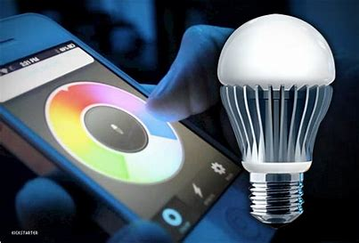
GENERAL UTILIZATION
Lights are usually controlled by ON/OFF switches.
Lights can also be controlled by connecting to a hardware and software but can not detect human.

Slide 5
PROBLEMS
People often forget to turn off the light in their house.
There is also a problem of the use of excessive amounts of light known as over-illumination.

Slide 6
LITERATURE Survey
TITLE | CONCEPT
Automatic Light Control System By Mohd Amir Hamzah In 2009 | Comparing the surrounding light and the light intensity in the room to determine whether to switch on the light or not, Heat up pretty fast when the system is turn on.
Intelligent Lighting System for Commercial Building By Sukor Bin Muhammad In 2009 | The intelligent lighting system designed by him only focused on using occupancy sensor and photosensor to automatically turn on and off the lights.

Slide 7
LITERATURE SURVEY
TITLE | CONCEPT
Home Automation Lighting System By Goh Lin Chian In 2009 | The system used motion detector to detect passerby in the area to automatically turn on and off the lights. He also used GUI and LAN.
Automatic Street Light Control By Sudhakar & Anil In 2013 | Automatic Street Light Controlling System puts up a very user friendly approach and could increase the power saving. (uses LDR)
Automatic LED emergency Light By Darshil In 2014 | Describes the design of an LED emergency light that switches on automatically when main power fails, keeps charging respectively.

Slide 8
OBJECTIVE OF THE EXISTING SYSTEM
To automatically turn on/off the lights.
To control the room’s brightness.

Slide 9
DISADVANTAGES OF EXISTING SYSTEM
Troubleshoot is difficult.
Can’t count the persons in room.
Window blinds can’t be controlled.

Slide 10
Objective of proposed system
To automatically turn on/off the lights.
To control the room’s brightness(control the intensity of brightness, window blind).
To count the number of people in the room.

Slide 11
ADVANTAGES OF PROPOSED SYSTEM
Troubleshoot of problem is simple.
Manual assistance is reduced.
Can count the person’s in room.

Slide 12

HARDWARE IMPLEMENTATION
Door sensor
Light Sensor
Motorized Window Blind

Slide 13
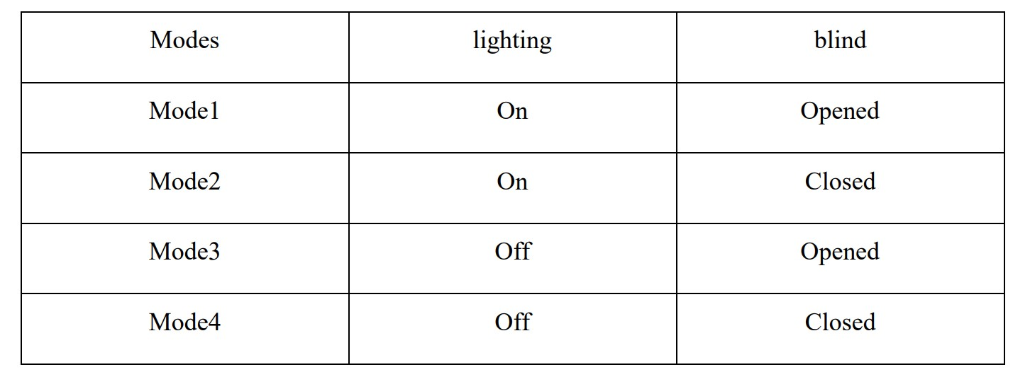
SOFTWARE IMPLEMENTATION
Programming ATmega16C
Automatic Operation
Choose from certain modes

Slide 14
TITLE:
Automatic street light control system using wireless sensor networks
AUTHORS AND YEAR | EXISTING SYSTEM | PROPOSED SYSTEM | METHODOLOGY | ADVANTAGES | DISADVANTAGES
Dhiraj Sunehra & Sangem Rajasri | Conventional street light manually controlled | Automatic street light control system wireless sensor networks (WSN) | PIR,LDR and LEDs are used for automatic light control | Reduce the energy consumption | Batteries should be changed frequently.

Slide 15
TITLE: Automatic Street Light Control System
AUTHORS AND YEAR | EXISTING SYSTEM | PROPOSED SYSTEM | METHODOLOGY | ADVANTAGES | DISADVANTAGES
Kapse Sagar Sudhakar & Abhale Amol Anil | Manual work of street light by officers | street light control system using IR sensor and LDR | IR,LDR are used with circuits for light control | In sunny and rainy days, ON and OFF time differ noticeably | Snow, dust or moisture effects the light control.

Slide 16
TITLE: A Dynamic And Automatic Traffic Light Control System For Solving The Road Congestion Problem
AUTHORS AND YEAR | EXISTING SYSTEM | PROPOSED SYSTEM | METHODOLOGY | ADVANTAGES | DISADVANTAGES
W. Wen & C. L. Yang | Based on timer traffic signal changes | A model coded in Arena to help design the system | Adopts average arrival time and departure times | Congestion Problem of traffic is reduced to great number | Very expensive and experts needed

Slide 17
CONCLUSION
The best method is implemented which is effective and efficient lighting control system which controls room’s intensity and counts the number of people in the room and the software and hardware requirements are implemented, using DC motor the room’s window blind’s are controlled which helps in reduce electronic wastage by using natural light respectively.

Slide 18
REFERENCES
Thomas L.F (2008) Electronic Device.8th Edition. New Jersey: Prentice Hall
Rudiger Ganslandt and Harald Hofmann (1992), Handbook of Lighting Design, Erco Edition. Germany: Verlag Vieweg.
Derek Philips (2000), Lighting Modern Buildings, Woburn: Architectural Press.
Wikipedia, the free encyclopedia.

Slide 19

ANY QUERIES?

Slide 20



H NK YOU

